Slide 1
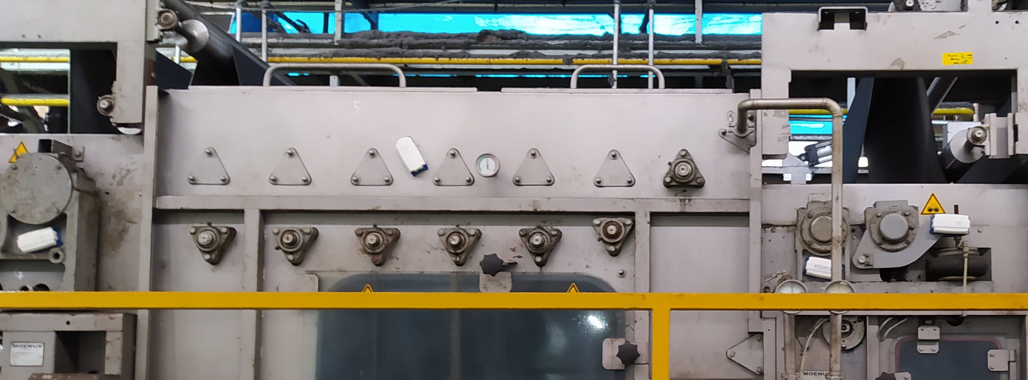

Edge-Based Vibration Monitoring System for Textile Machinery
Victor Lorhan Loiola Costa – Matric. 390048, 03.05.2022
Notes:
Good morning
My name is Lorhan Costa and I would like to present to you my intermediate presentation with title Edge Based Vibration Monitoring System for Textile Machinery

Slide 2
Contents
Motivation and Tasks
Theory Review
Concept
Current Status
Progress Overview
Edge-Based Vibration Monitoring System for Textile Machinery | 03.05.2022
Institut für Mensch-Maschine-Interaktion | www.mmi.rwth-aachen.de
Victor Lorhan Loiola Costa | lorhan.costa@rwth-aachen.de
Notes:
We start by explaining the motivation and tasks of the work.
Then we proceed to talk about the main theory behind the target application.
Next we explain the concept we want to develop.
Then we expose the status of the work.
Finaly, we summarize what was done and what we still want to achieve.

Slide 3
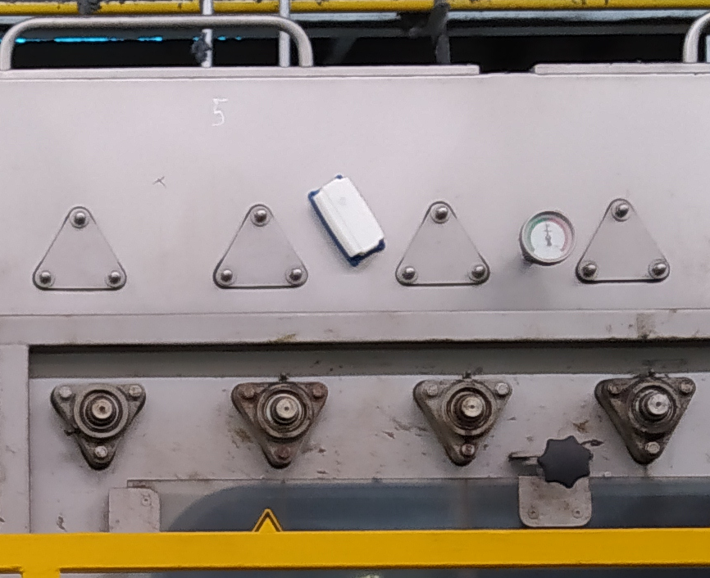
Motivation and Tasks
Intelligent Vibration Monitoring
Condition monitoring
Optimization of maintenance schedules
Reduced maintenance costs
Reduction of unscheduled machine stops
IoT
Sensor networks
Data generation, transmission and storage
Integration with cloud infrastructure
Edge computing
Descentralized
Efficient use of resources (energy, bandwidth, time...)
Source: DELTA Systems
Edge-Based Vibration Monitoring System for Textile Machinery | 03.05.2022
Institut für Mensch-Maschine-Interaktion | www.mmi.rwth-aachen.de
Victor Lorhan Loiola Costa | lorhan.costa@rwth-aachen.de
Notes:
Vibration monitoring is a key technique in the field of condition monitoring of industrial equipment.
It allows insights of the health of the equipment, which enables the optimization of maintenance schedules and reduced maintenance costs.
When it comes to a modern implementation of this technique, we must take two trends into account:
First, IoT concept sets current industrial monitoring standards in the direction of sensor networks that generate data and feed them to a cloud application.
Second, the edge computing concept comprises a distributed computational architecture that results in a reduced consuption of resources such as energy and bandwidth.
Here we can see an electronic vibration sensor from the company DELTA Systems installed in a textile manufacturing equipment in a plant in Turkey.

Slide 4
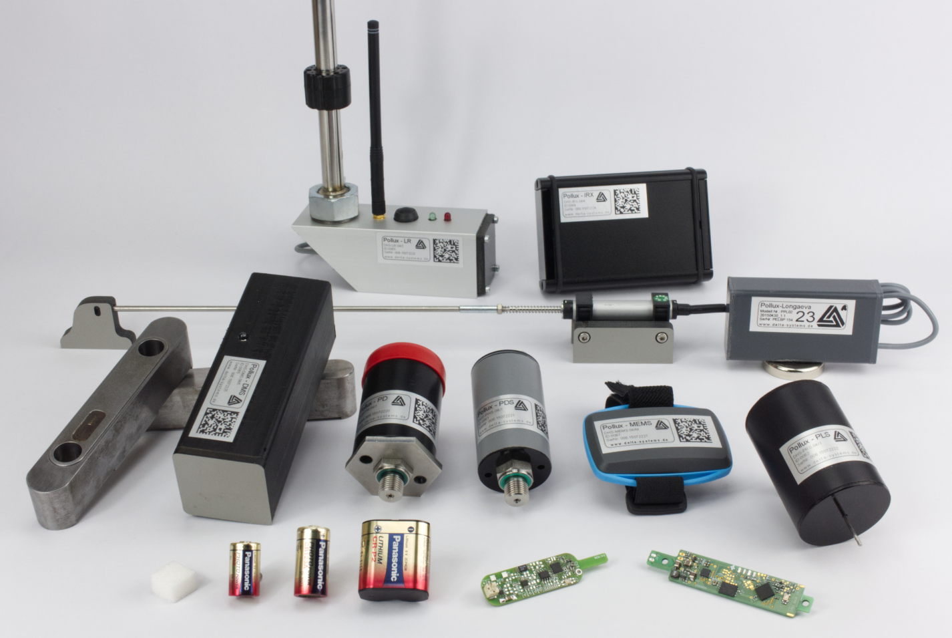
Motivation and Tasks
DELTA Systems GbR
Wireless sensor systems
Battery powered
Radio communication
Development
Hardware
electronics, mechanics
Firmware
microcontroller systems, embedded Linux
Software
GUI‘s, data analysis, database & cloud connectivity...
Source: DELTA Systems
Edge-Based Vibration Monitoring System for Textile Machinery | 03.05.2022
Institut für Mensch-Maschine-Interaktion | www.mmi.rwth-aachen.de
Victor Lorhan Loiola Costa | lorhan.costa@rwth-aachen.de
Notes:
The company where this work was developed, DELTA Systems, comes into play to supply industry and research demands in this context.
We develop the whole technology chain used for these tasks:
We develop HW in the form of electronic systems and their associated mechanics.
We develop FW in the form of microcontroller systems and embedded Linux.
And we also develop SW in the form of GUI‘s, data analysis and database and cloud connectivity.

Slide 5
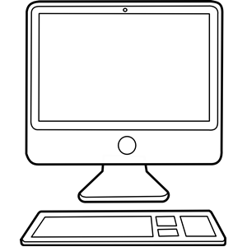
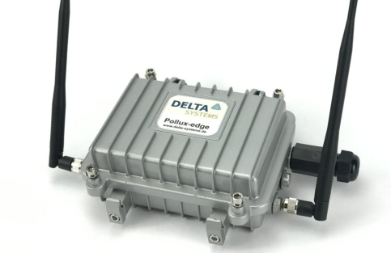
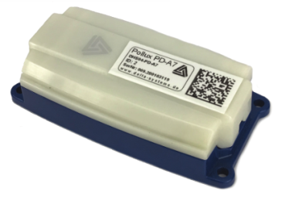
Concept
Technology Stack
Remote connection to gateway
DB Access
GUI Access
Linux
Python
SQLite DB
uC
C language
Memory chips
Edge computing units
RDC/Rest/Web
(TCP/IP)
Custom protocol over radio
Source: DELTA Systems
Source: DELTA Systems
Closer to user Closer to source of data
Edge-Based Vibration Monitoring System for Textile Machinery | 03.05.2022
Institut für Mensch-Maschine-Interaktion | www.mmi.rwth-aachen.de
Victor Lorhan Loiola Costa | lorhan.costa@rwth-aachen.de

Slide 6
Concept
KMeans
MVGD
Control Charts
Dashboard app
Technology Stack
Fourier Transform
Diginal Filters
GUI (by accessing gateway)
Edge computing units
RDC/Rest/Web
(TCP/IP)
Custom protocol over radio
Source: DELTA Systems
Source: DELTA Systems
Closer to user Closer to source of data
Edge-Based Vibration Monitoring System for Textile Machinery | 03.05.2022
Institut für Mensch-Maschine-Interaktion | www.mmi.rwth-aachen.de
Victor Lorhan Loiola Costa | lorhan.costa@rwth-aachen.de

Slide 7
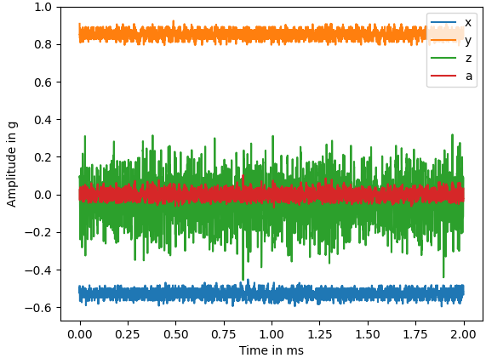

Concept
Long measurements
Whole XYZ signals
FFT in gateway computer
2x per day
~ 3.64 Ws
Short measurements
Only max. values of XYZ
Every ~ 15 min
~ 0.05 Ws
Database
Nov 2021
426.929.467 datapoints
Short and long mms
496 days of operation
Vibration Signals
2s @ 4.5 kHz
X, Y and Z axes
$$a=\sqrt{x^{2}+y^{2}+z^{2}}$$
Edge-Based Vibration Monitoring System for Textile Machinery | 03.05.2022
Institut für Mensch-Maschine-Interaktion | www.mmi.rwth-aachen.de
Victor Lorhan Loiola Costa | lorhan.costa@rwth-aachen.de

Slide 8
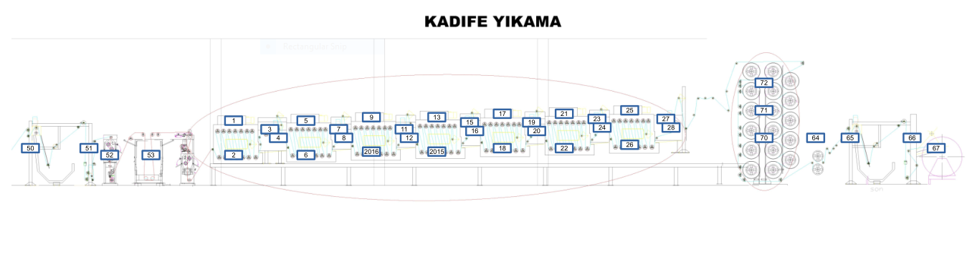
Extra Slides
Sensor Placement
Edge-Based Vibration Monitoring System for Textile Machinery | 03.05.2022
Institut für Mensch-Maschine-Interaktion | www.mmi.rwth-aachen.de
Victor Lorhan Loiola Costa | lorhan.costa@rwth-aachen.de

